Slide 1

A COMPARATIVE ANALYSIS OF SALES FORECASTING
MACHINE LEARNING PROJECT

Slide 2

CONTENT
MOTIVATION & OBJECTIVE
DATA COLLECTION
EXPLORATORY ANALYSIS
METHODOLOGY
DATA PREPROCESSING
MODEL DEVELOPMENT
MODEL EVALUATION & VALIDATION
MODEL INTERPRETATION
CONCLUSION
CHALLENGES & NEXT STEPS

Slide 3

MOTIVATION & OBJECTIVE
Past research has used different models to do sales forecasting.
By developing Machine Learning and AI, nowadays businesses can have more interest in anticipating market situation.
This research is novel because we took a Comparative ensemble approach from a traditional vs modern perspective.
Notes:
Businesses need sales forecasting knowledge from their historical data so as to enable better financial planning, budget allocation, and strategic decision-making.
Therefore, we set out to use the diverse methodologies available for Sales Forecasting. XGBoost, Random Forest, and Linear Regression. They have been relied upon for this task. However, Neural Networks (NNs) offer unique advantages, particularly in handling vast datasets and capturing intricate interdependencies among variables, including non-linear relationships. Hence, this research aims to compare the performance of baseline models (XGBoost, Random Forest, and Linear Regression) against a Neural Network model for sales forecasting, enabling a comprehensive analysis of their predictive capabilities

Slide 4
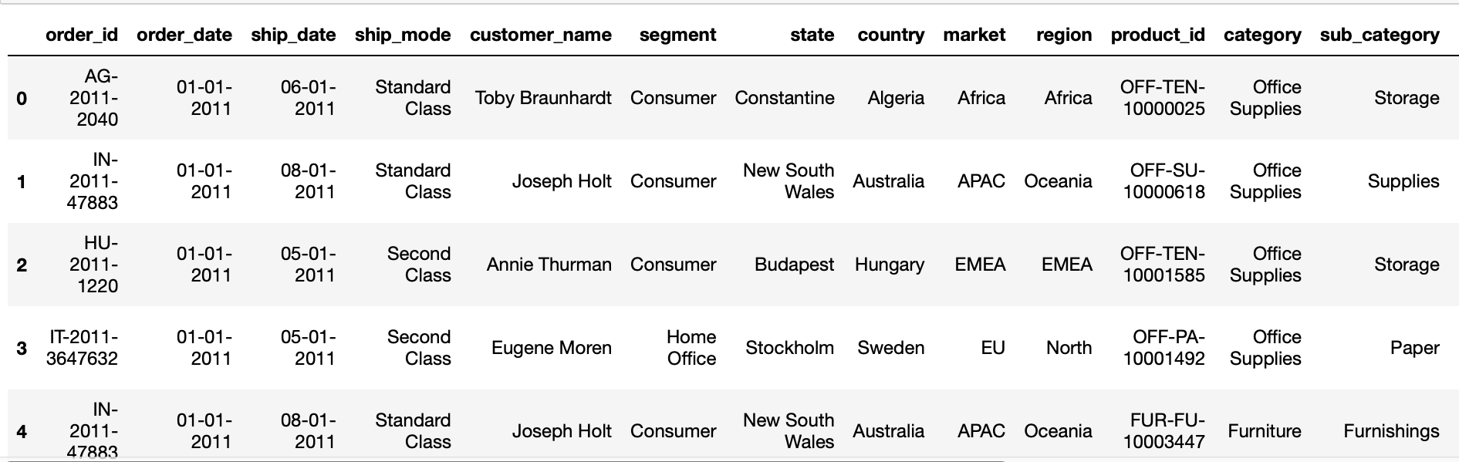
DATA COLLECTION
Superstore Dataset
21 variables
51,290 observations.
Each record = 1 product purchase.
https://www.kaggle.com/datasets/aditisaxena20/superstore-sales-dataset

Slide 5
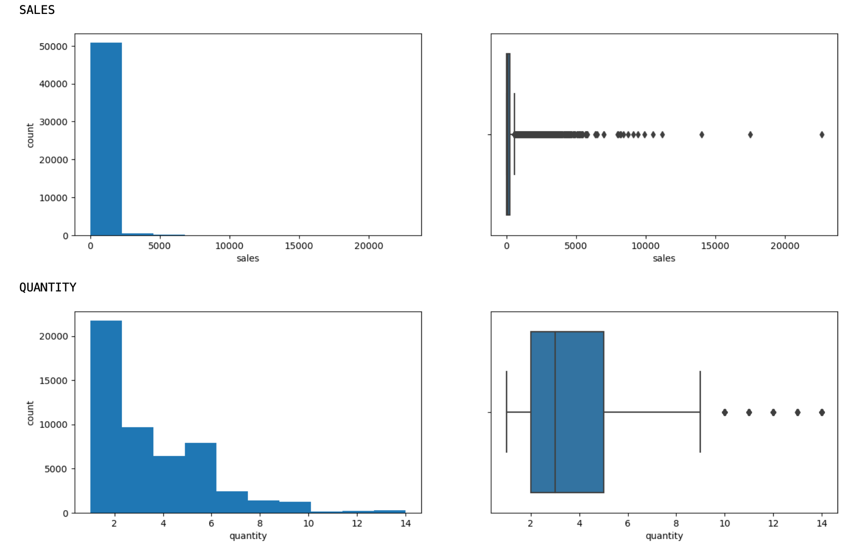
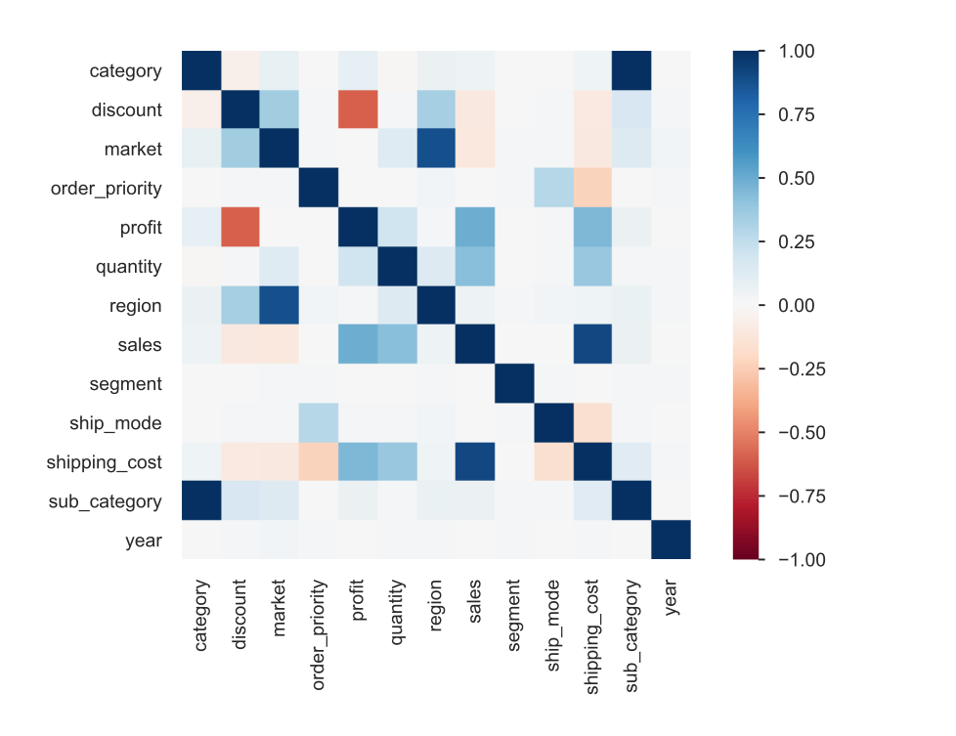
EXPLORATORY ANALYSIS:
Data Profiling
Notes:
In this research we attempted to adjust for outliers, skewness and which products were top selling. The profiling of our dataset shows us the following:
There are no missing values, neither duplicates.
The category variable is highly correlated with the sub category variable.
The market variable is highly correlated with the region variable.
The profit variable is highly correlated with the discount variable. It can be considered to use only one of them during the feature selection of the modeling.
The sales variable is highly correlated with the Shipping cost variable.
The distributions of the numerical variables are skewed and they present outliers.

Slide 6
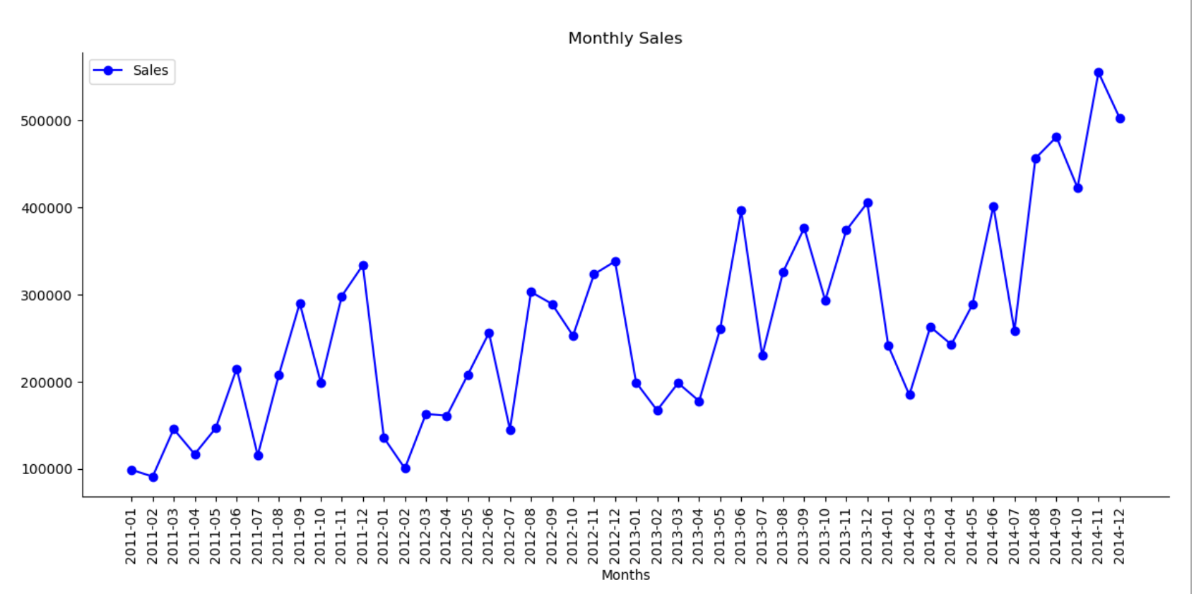
EXPLORATORY ANALYSIS
Sales Trend Analysis
Notes:
INSIGHTS FROM EDA:
We can see that over the 4 years span of our historical data, the yearly total sales increases around 20% each year.
Based on monthly period, in all the 4 years, each year starts low the first 3 months and the sales raise quite significantly on August and September, drop slightly on October and raise again on Novembers and Decembers.\ This fluctuating pattern makes all its sense as on August and September, people makes more purchase for the start of the school year. On November and December, people tends to buy a lot for thanksgiving and Christmas.
The top selling products are mostly smartphone or something related to technology. This is for sure due to the unit price of those item which is relatively high compared to office supplies.
Related to customers behavior, the top clients resides in the US and from the Consumer Segment which pays almost 50% of the total sales.

Slide 7
METHODOLOGY
DATA PREPROCESSING
MODEL DEVELOPMENT
MODEL EVALUATION & VALIDATION
MODEL INTERPRETATION
1
2
3
4

Slide 8
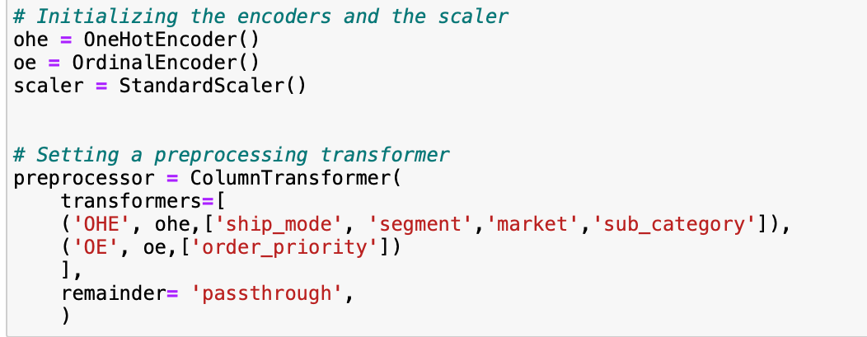
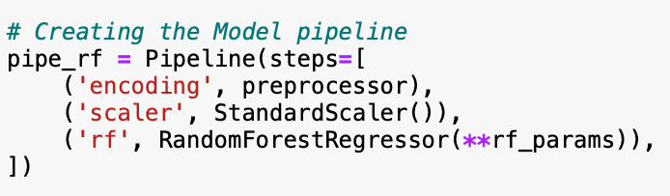
DATA PREPROCESSING
Features Selection: 20 independent variables to 10
Feature Engineering:
Encoding Date variables
Handling Outliers using IQR
Encoding Categorical features
Scaling the data
Data leakage control: Column transformer through pipeline on splitted data.
Notes:
FEATURE SELECTION:
For the modeling, we decided to reduce the number of features from the 20 original variables.
So we will drop order_id as it won't have any impact on predicting sales.
Also we will drop year column as we will extract from order_date the year, month and day.
We will let go categorical features that have too high unique values (customer_name, product_name, product_id, country, state) because encoding them will make sparse a lot our features number at the end. On the other side we opt to keep their equivalent with reasonable number of unique values: segment to represent the customers, sub_category for products (we opt for this as category is too general compared to sub_category), and market to represent the country (market has less unique values than region).
We decided to drop also the profit column as it is a variable that depends on sales.
At the end, we will stay with 14 independent variables.
FEATURE ENGINEERING
First thing that will be done is encoding the date variables: order_date , ship_date, meaning extracting day, month and year.
As we saw earlier from the EDA that our numerical values have outliers. To handle them we will use the threshold capping method or IQR.
Before applying any further preprocessing, we will split at this point our data set into train data set and test data set. It's on them that we will perform the following process:
We will create a column transformer that includes the encoding of the categorical data that we will pass to the pipeline of the modeling after. Note that except for the order_priority column, all the categorical variables will be onehot-encoded. order_prioritywill be encoded with OrdinalEncoder.
Also in that pipeline, we will pass a Standard Scaler to scale our data. We proceed this way to control possible data leakage.

Slide 9
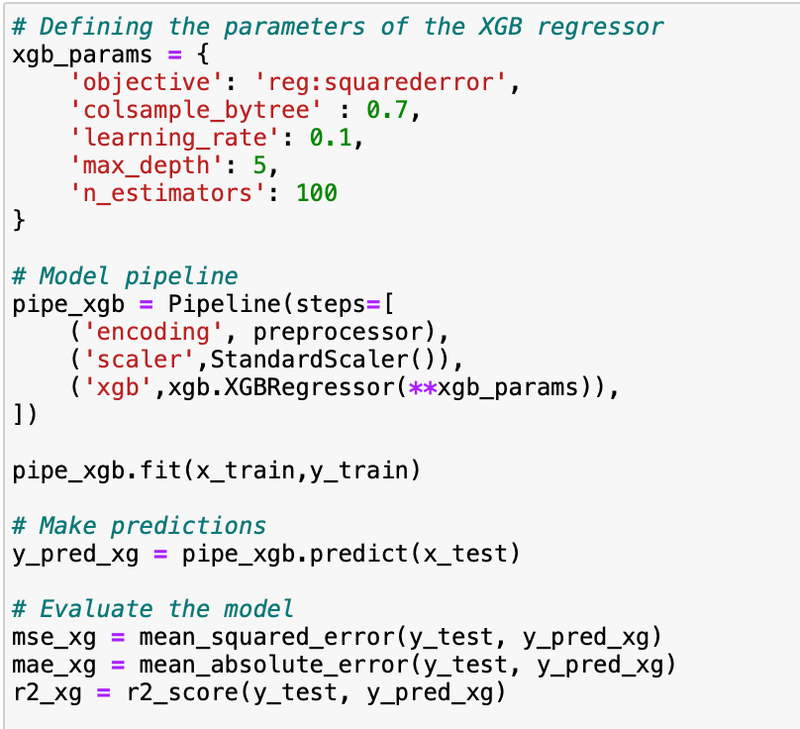
MODEL DEVELOPMENT
3 baseline Models:
Linear Regression (LR)
Random Forest (RF)
XGBoost (XGB)
1 Deep learning Model: Neural Networks (NN)
Metrics: R2, MSE, MAE
Perform tuning on the most performant model
Notes:
MODELS SELECTION:
The initial idea of this study was to compare the performance of the traditional approah Linear Regression with the one of a Neural network. Both are common techniques used in sales forecasting. Neverthless, we decided at the end to incorporate also two decision tree-based algorithms which are Random Forest and XGBoost. Moreover, they are part of what is called Ensemble methods which in general can create a more accurate prediction. Besides, they are particularly common in sales forecasting due to the fact that they can help identify most important factors that can influence sales.
For each algorithm, we will:
create the model,
fit it on our train data set,
make prediction using the test data set,
evaluate* the model performance (Mean Squarred Error MSE, Mean Absolute Error MAE, R2 score),\
interpret by checking the features importance*.
Then we will compare the performance of the Linear Regression model, the random Forest Model and the XGBoost model.
BASELINE MODELS
XGBoost: XGBoost is a gradient boosting algorithm that efficiently implements ensemble learning, particularly for regression and classification problems.
Random Forest: Random Forest is an ensemble learning method that constructs multiple decision trees during training and outputs the mode of the classes (classification) or mean prediction (regression) of the individual trees.
Linear Regression: Linear Regression is a statistical method used to model the relationship between a dependent variable and one or more independent variables by fitting a linear equation to the observed data.
Neural Network: A Neural Network is a computational model inspired by the structure and function of the human brain, composed of interconnected nodes (neurons) organized in layers, designed to recognize patterns and relationships in data.

Slide 10
MODELS EVALUATION AND VALIDATION
 | LINEAR REGRESSION | RANDOM FOREST | XGBOOST | NEURAL NETWORK | TUNED XGBOOST
R SQUARE | 85.68% | 88.02% | 89.57% | 90% | 90.05%
MSE | 5217 | 4364.21 | 3798.56 | 3626.20 | 3624.78
MAE | 48.17 | 37.23 | 35.37 | 34.76 | 34.41
RESULTS:
The NN marginally yields the best performance.
This is decided on: highest R square and lowest MSE and MAE
The baseline model is effective for sales forecasting.
VALIDATION: XGBoost tuned with GridSearchcv

Slide 11
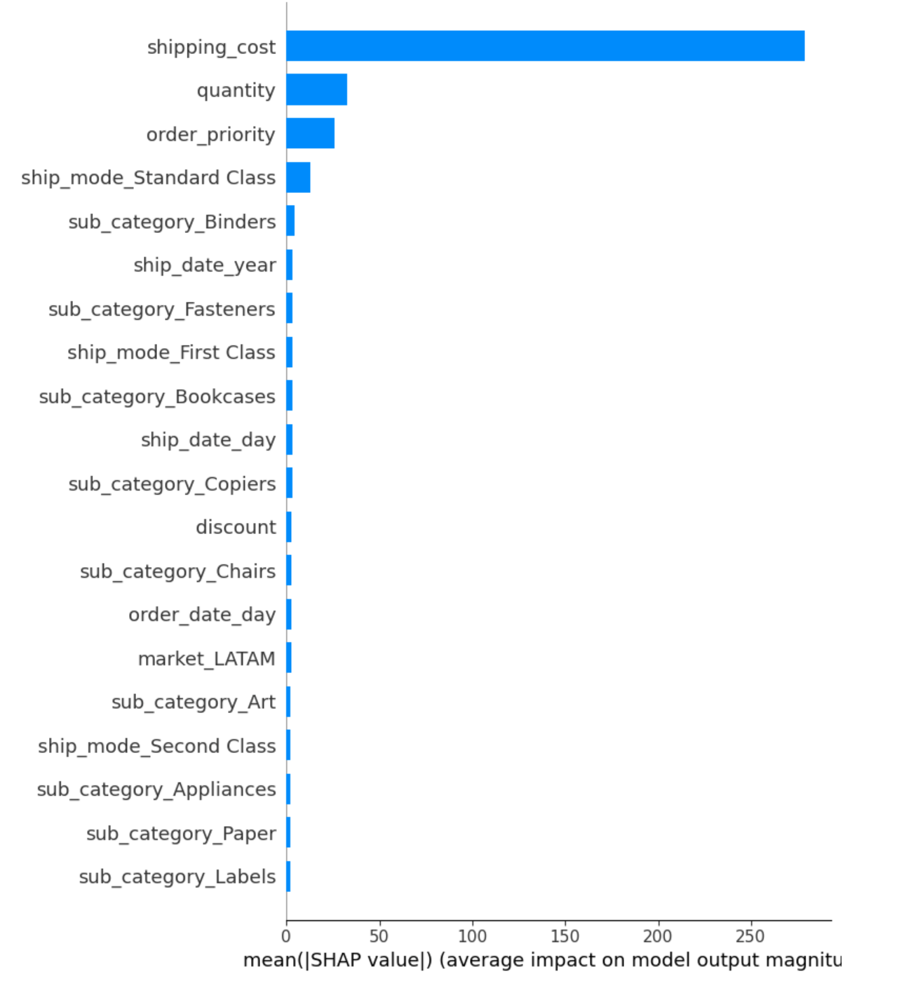
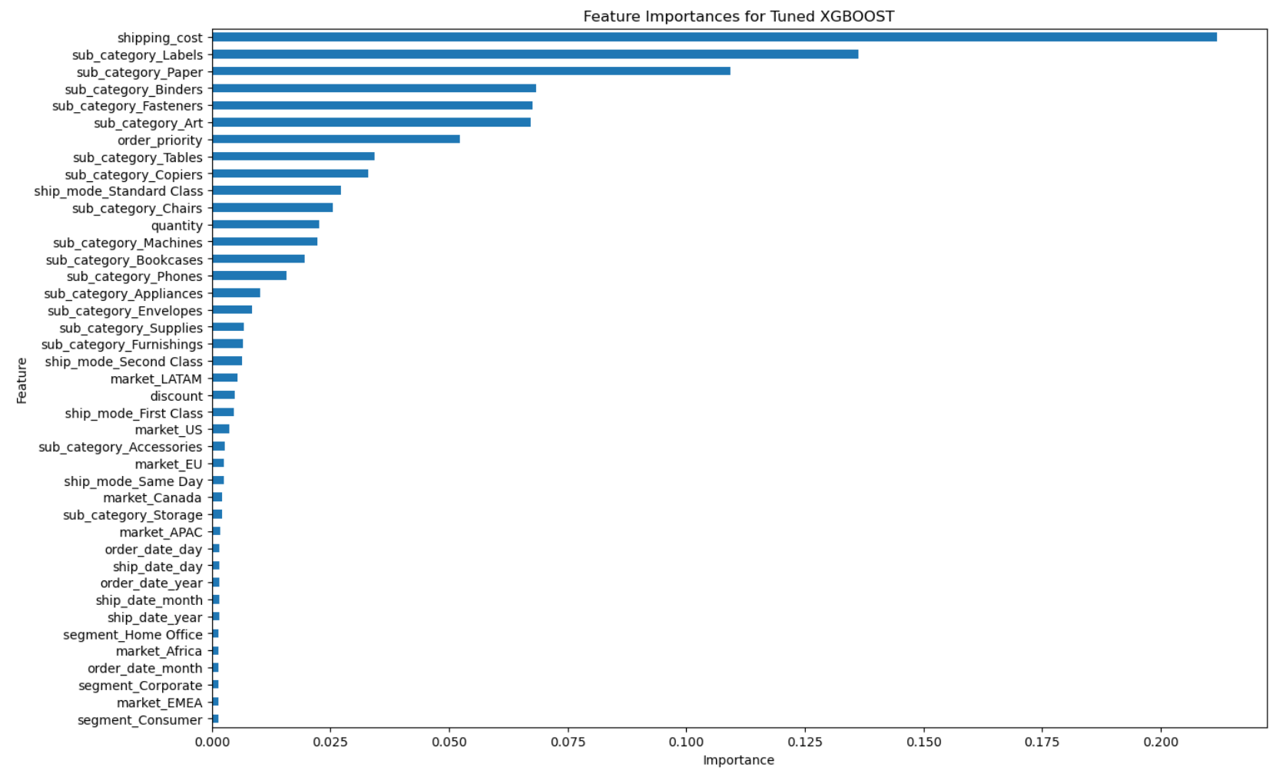
MODEL INTERPRETATION
Model Interpretation using
SHAP explainer
Feature Importance of the model
Most Impacting Feature:
Shipping Cost
Notes:
A limitation observed, is that while Shipping cost vary directly with sales in the exploratory analysis phase. We realized that it had little to no explanatory power on sales forecasting model. Given more time, we could learn to understand intuitively the reason for this phenomena.

Slide 12
CONCLUSION
For Business application purposes, the Neural Network algorithm on sales forecasting will yield an approximate goodness of fit of 90%. This is significant compared to a simple linear regressions.
NN compared to other sophisticated ML algorithms does perform better. However, XGboost delivers nearly the same performance on the predictions. Random Forest, slightly less but not by far. Additionally, both XGBoost and Random Forest are easier to implement and to interpret.
Conducting sale forecasting using Machine Learning is a powerful tool for Businesses to anticipate future demand and adjust their strategies accordingly.

Slide 13

WRAP UP
NEXT STEPS:
Use powerful traditional time series models like ARIMA to predict sales and compare with our regression results.
Plotting the predicted values against the actual values to determine which model overfits or underfits.
Tune the Neural Networks to find the optimum performance.

Slide 14

THANK YOU

